Slide 1


CUSTOMER SATISFACTION

Slide 2
INTRODUCTION
Important asset of organization-Customer
Organization success –No of customer it has
Frequent buying, prompt payment-increase cash flow
Measure of quality-Customer satisfaction
Reflected in Malcom Baldrige National Quality award.(Customer satisfaction accounts for 30% of total points)
It is woven throughout ISO 9001-2000

Slide 3
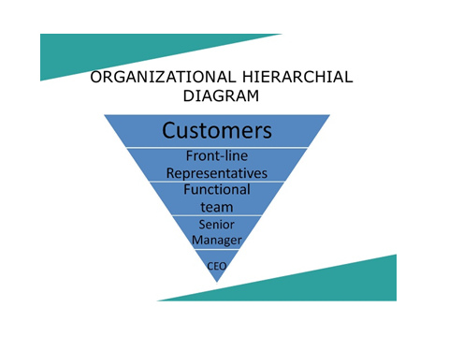

Slide 4
INTRODUCTION continued
Quality product or service –meets the needs at reasonable price (on time delivery and outstanding service)
Customer satisfaction is illustrated in Teboul model.
Customer satisfaction is hard to measure, measurement is not precise.—most attitudes, variability among people same person at different times (Jarrat Rosenberg).
Customer satisfaction should not be viewed in vacuum.
The value customer place on one product compared to another –Customer loyalty.
Sustained by maintaining a favourable comparison when compared with competitors.(Robert Gardner)

Slide 5
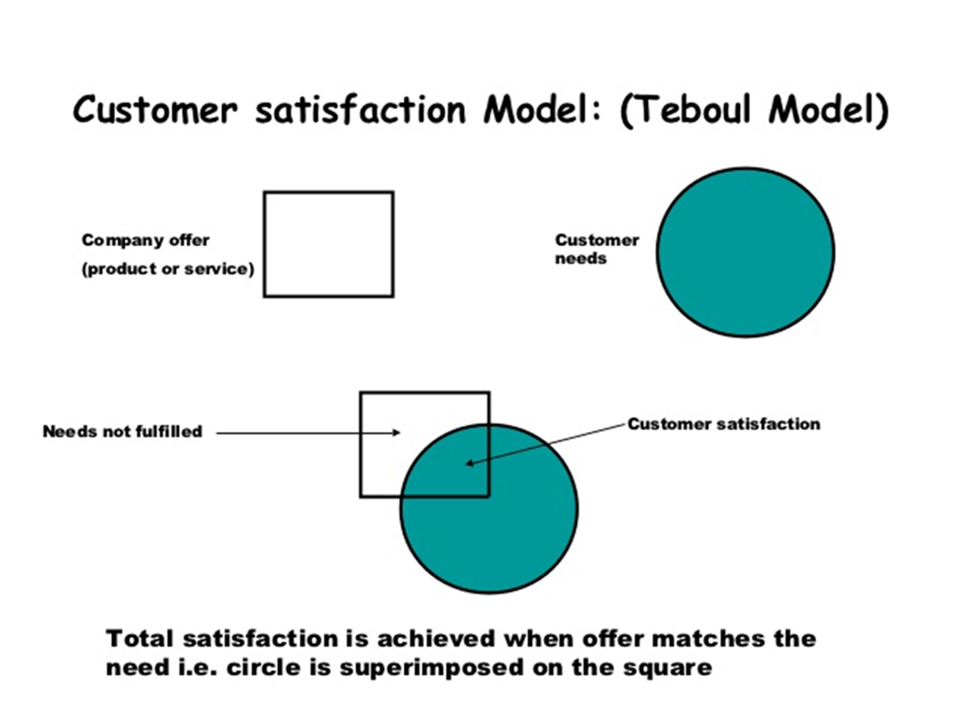

Slide 6
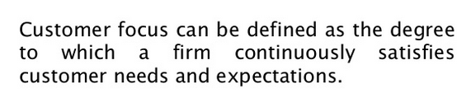
Customer perception of quality

Slide 7
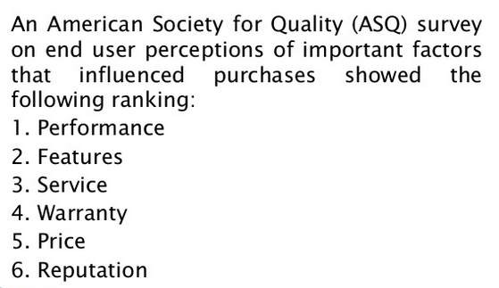
American Society for Quality (ASQ) Ranking

Slide 8
1. Performance: Product or service is ready for use, availability, reliability, maintainability
2. Features: Identifiable feature of product or service are psychological.
3.Service: Is emerging as a method for organization to give the customer-added value.
Customer service is intangible. Made up of small things,
not quantifiable
Providing customer service is different from and more difficult to achieve than excellent product quality.
4.Warranty : Organisations public promise of a quality product backed up by a guarantee of customer satisfaction.
Warranty forces organization to focus on the customers definition
Generates more sales from existing customers by enhancing loyalty.

Slide 9
5. Price: Todays customer pay higher price to obtain value.
They are constantly evaluating one organizations product against those of its competitors.(Greatest value)

Slide 10

Customer complaints
Organisations use customer dissatisfaction as primary measure to assess their process improvements.
The feedback obtained in all above cases is proactive
Customer complaint is reactive but very useful
ASQ SURVEY REVEALS THAT ABOUT
1.5% COMPLAINTS REACH TOP MANAGEMENT
20% TO FRONT LINE PERSONNEL
80% DON’T REPORT

Slide 11
Customer complaints
It indicates that it is easy for the top management to perceive that every thing is ok
When satisfied customers r included in the data, no. of complaints to management is lower than 1.5%
Frequently dissatisfied customers don’t say anything & quietly switch over to competitor

Slide 12
Customer complaints
Those who don’t complain r the one who should worry the organization most
By taking the positive approach to the complaints it is possible to improve the products/services
In fact complaints give the organization a second chance

Slide 13
ONCE U HAVE IDENTIFIED THE COMPLAINTS/ PROBLEMS
NOW TURN TO ELIMINATION.
INCORPORATE CUSTOMER VOICE INTO PRODUCT/ SERVICE

Slide 14
Service quality
Elements of customers service are
Organization
Customer care
Communication
Front line people
Leadership

Slide 15
CUSTOMERS’ REQUIREMENTS
NORMAL REQUIREMENTS Are typically what one gets by just asking customers what they want.
EXPECTED REQUIREMENTS Are the obvious / compulsory requirements. For example, if meal is served hot, customers barely notice it. If it's cold or too hot, dissatisfaction occurs. Expected requirements must be fulfilled.
EXCITING REQUIREMENTS
Beyond the customer's expectations.
If provided , customer would be excited
If not ,they would hardly complain

Slide 16
IN OTHER WORDS
NORMAL REQUIREMENTS
More is better
EXPECTED REQUIREMENTS
Must be
EXCITING REQUIREMENTS
Delightening, exciting, wow factor

Slide 17
KANOS MODEL
If the requirement is absent it does not cause dissatisfaction, but it will delight clients if present - "camera options"
Satisfaction
MORE IS BETTER
+
The more requirements are met the more one is satisfied
EXCITERS
Service Dysfunctions
Service Fully Functions
-
+
Must Be
Less satisfied when the product or service is less functional, but cannot increase satisfaction substantially if operational - "up-time"
-
Dissatisfaction

Slide 18
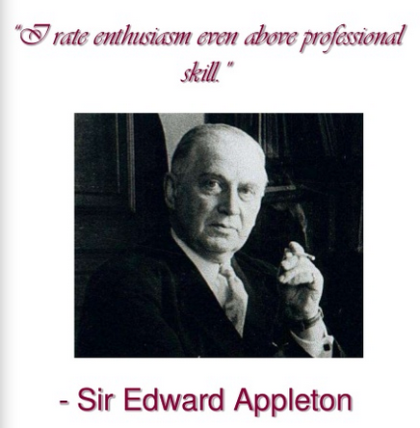
Employee involvement

Slide 19
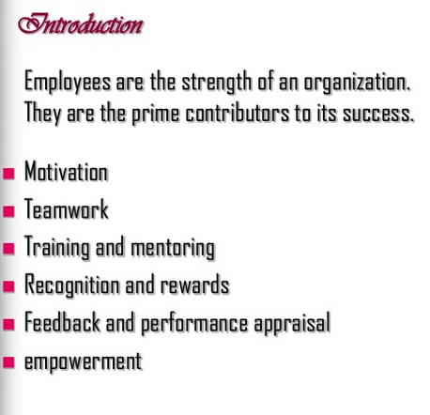

Slide 20
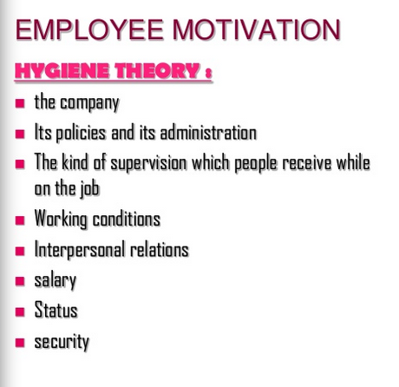

Slide 21
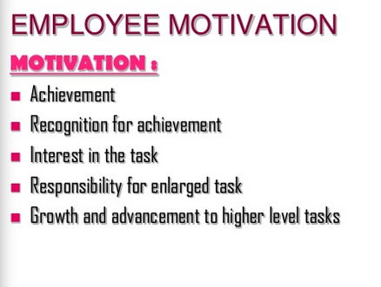

Slide 22
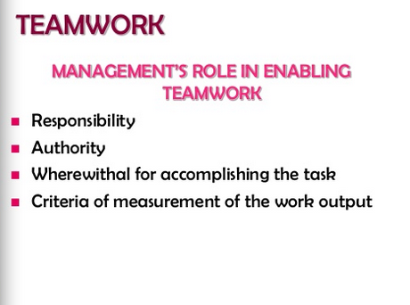

Slide 23
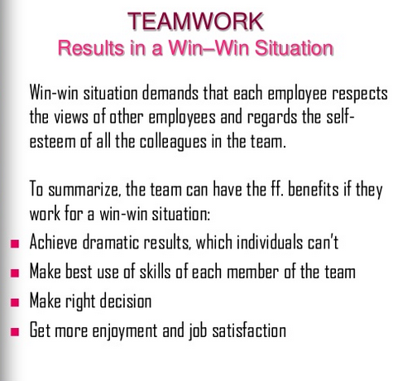

Slide 24
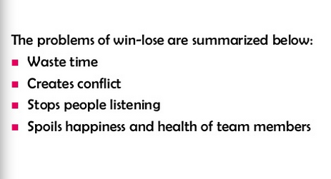

Slide 25
Empowerment
Everyone must understand the need for change
The system needs to change to the new paradigm
The organisation must enable its employees.

Slide 26
Suggestion system
Be progressive
Remove fear
Simplify
Respond quickly
Reward the idea

Slide 27
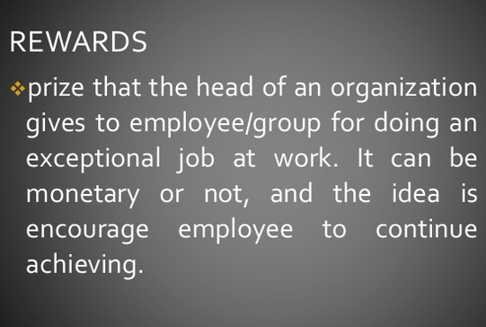
Recognition and Rewards

Slide 28
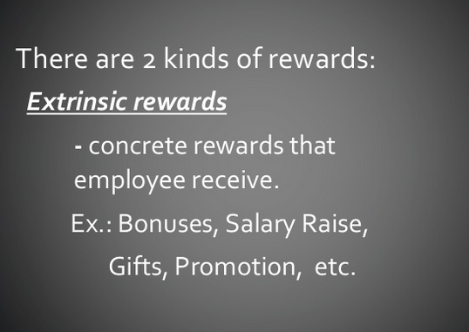

Slide 29
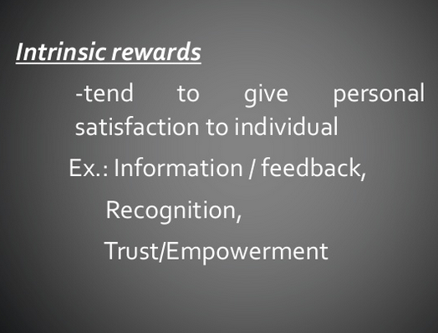

Slide 30
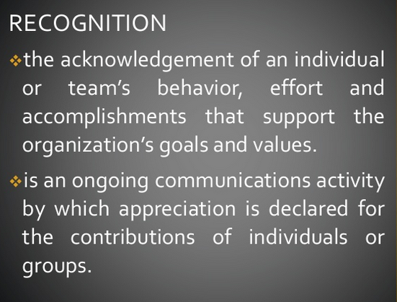

Slide 31
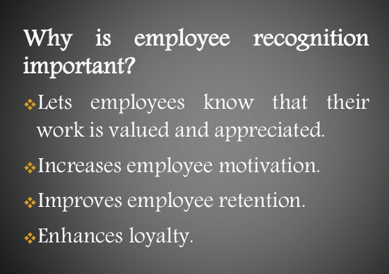

Slide 32
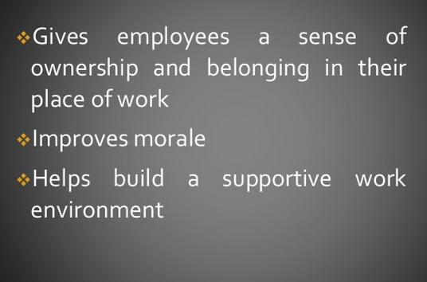

Slide 34
https://www.slideshare.net/thediaryrose/rewards-and-recognition-in-tqm

